Slide 1

Middleware in MVC Core

Slide 2
What is Middleware?
Middleware is a piece of code in an application pipeline used to handle requests and responses.
For example, we may have a middleware component to authenticate a user, another piece of middleware to handle errors, and another middleware to serve static files such as JavaScript files, CSS files, images, etc.
Middleware can be built-in as part of the .NET Core framework, added via NuGet packages, or can be custom middleware. These middleware components are configured as part of the application startup class in the configure method. Configure methods set up a request processing pipeline for an ASP.NET Core application. It consists of a sequence of request delegates called one after the other.

Slide 3
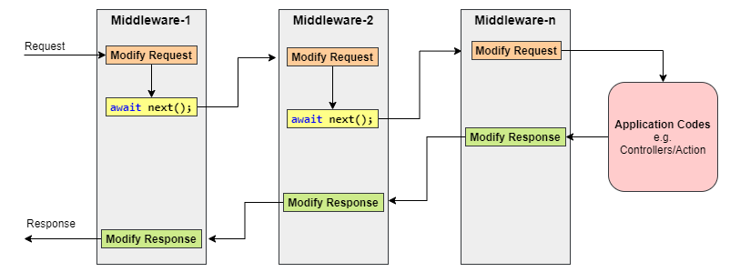
Diagram
Generally, each middleware may handle the incoming requests and pass execution to the next middleware for further processing.
However, a middleware component can decide not to call the next piece of middleware in the pipeline. This is called short-circuiting or terminating the request pipeline. Short-circuiting is often desirable because it avoids unnecessary work. For example, if the request is for a static file like an image CSS file, JavaScript file, etc., these static files middleware can handle and serve that request and then short-circuit the rest of the pipeline.

Slide 4
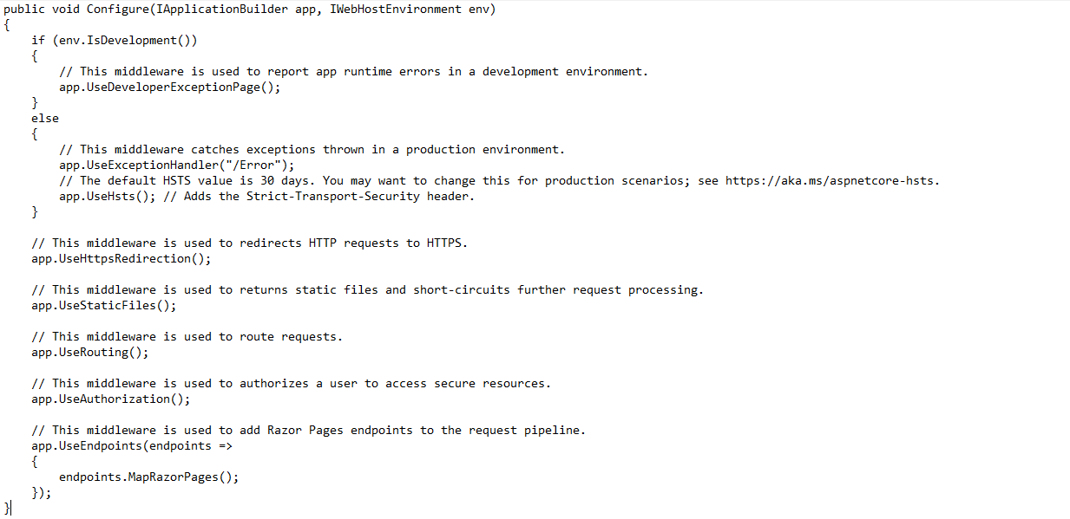
Example

Slide 5
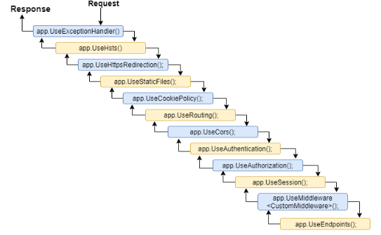
Example
Middleware Ordering
Middleware components are executed in the order they are added to the pipeline, and care should be taken to add the middleware in the right order; otherwise, the application may not function as expected. This ordering is critical for security, performance, and functionality.
The following middleware components are for common app scenarios in the recommended order.

Slide 6
The first configured middleware has received the request, modified it (if required), and passed control to the next middleware. Similarly, the first middleware is executed at the last while processing a response if the echo comes back down the tube. That’s why Exception-handling delegates need to be called early in the pipeline, so they can validate the result and display a possible exception in a browser and client-friendly way.

Slide 7
What is Run Method
This middleware component may expose Run[Middleware] methods that are executed at the end of the pipeline. Generally, this acts as a terminal middleware and is added at the end of the request pipeline, as it cannot call the next middleware

Slide 8
What is Use Method
This is used to configure multiple middleware, unlike app.Run(), We can include the next parameter into it, which calls the next request delegate in the pipeline. We can also short-circuit (terminate) the pipeline by not calling the next parameter.

Slide 9
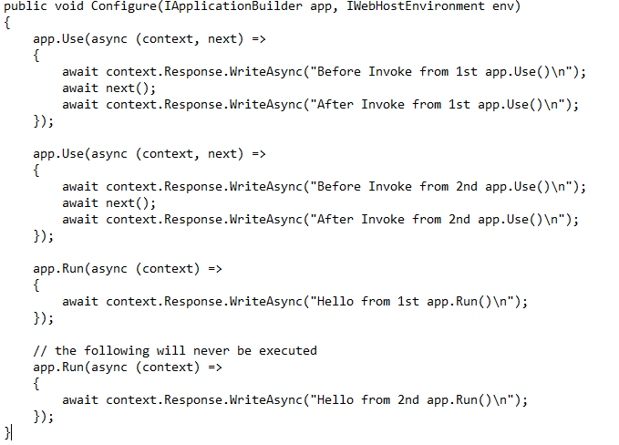
Sample Program of Use and Run Method

Slide 10
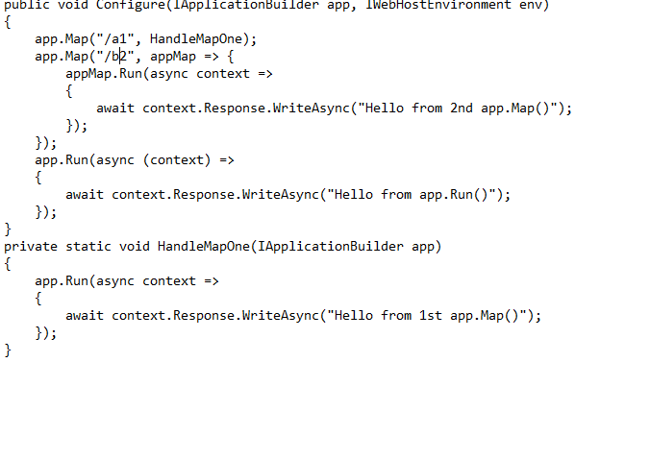
What is map Method
These extensions are used as a convention for branching the pipeline. The map branches the request pipeline based on matches of the given request path. If the request path starts with the given path, the branch is executed.

Slide 11
In summary, every middleware component in ASP.NET Core.
Has access to both the incoming requests and the outgoing response.
May simply pass the request to the next piece of middleware in the pipeline.
May perform some processing logic and then pass that request to the next middleware for further processing.
May terminate(short-circuit) the request pipeline whenever required.
They are executed in the order they are added to the pipeline

